Slide 1
RUNNING AN AUCTION USING BLOCKCHAIN
Isha Patel

Slide 2

Purpose
Blockchain is a fairly new technology.
Emerged with BitCoin
Not widely known
There are many uses of blockchain.
Used to manage an auction
Safe, secure, and accurate
hiclipart.com

Slide 3
Goal
The goal was to build a smart contract of a blockchain-based auction.
Addition of the Vickrey auction
Highest bidder pays second-highest bid

Slide 4
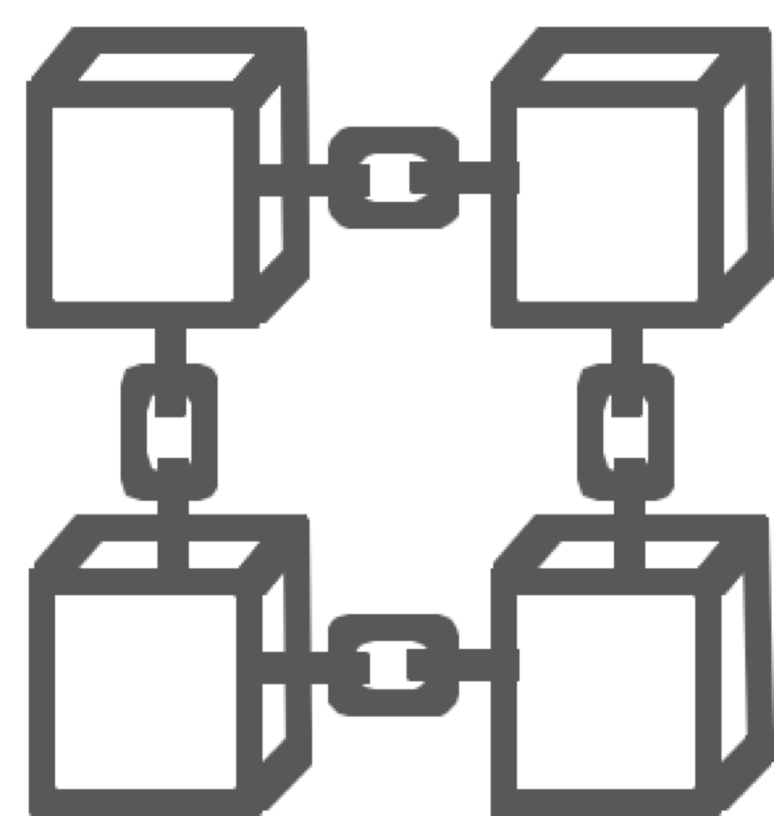
Blockchain
What is that?
A blockchain is a digital ledger that records all transactions and stores each transaction as immutable blocks

Slide 5

Decentralized
Data is distributed throughout the whole network.
No central authority
Ledger visible to network
Private individual identities
flaticon.com/authors/ddara

Slide 6
Immutable
Blocks are connected by their hashes.
Hashing: generating a fixed-length output from a given input
Hash: the output value generated from an input value that was put through a hash function
Hashing makes it almost impossible to alter the ledger.

Slide 7
Hashing
Block A
John: -500 BTC
Karen: +500 BTC
Block B
Susan: -200 BTC
Karen: +200 BTC
Y72
Block C
Karen: -1000 BTC
Chris: +1000 BTC
5H8
Y72
5H8
9L6

Slide 8
Hashing
Block A
John: -600 BTC
Karen: +600 BTC
Block B
Susan: -200 BTC
Karen: +200 BTC
Y72
Block C
Karen: -1000 BTC
Chris: +1000 BTC
5H8
4WQ
5H8
9L6

Slide 9
51% Attack
51% of the network can topple a blockchain.
Has happened, but is rare
Not likely in a blockchain owned by one company
Block 43
Block 44
Block 45
Block 46
Block 47
Block 44
Block 45
Block 46
Block 47
Block 48

Slide 10


Procedures
Open-sourced code was used to set a foundation.
Remix: Ethereum IDE
Solidity
Vickrey auction feature
If statement for varied number of bidders
Auction was run multiple times for testing.
wikipedia.org

Slide 11
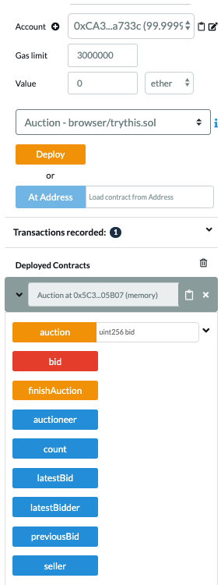

Slide 12
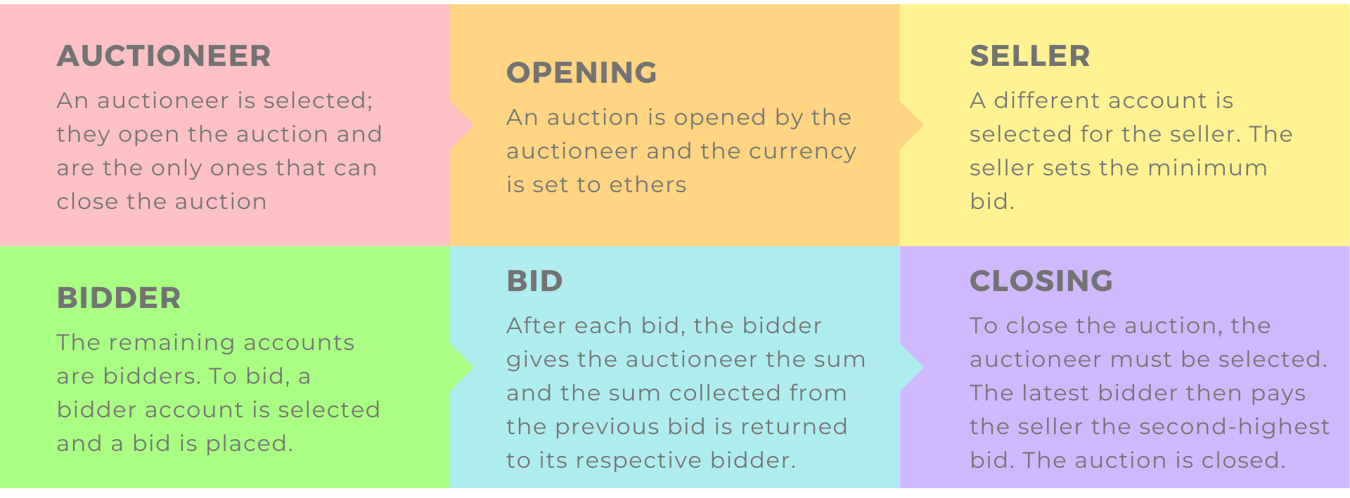
Running the Auction

Slide 13
Results
If there are no bids placed, the auction would be closed without any ethers spent.
If only one bid is placed, then the bidder pays that bid.
If more than two bids are placed, then the highest bidder pays the second-highest bid.

Slide 14
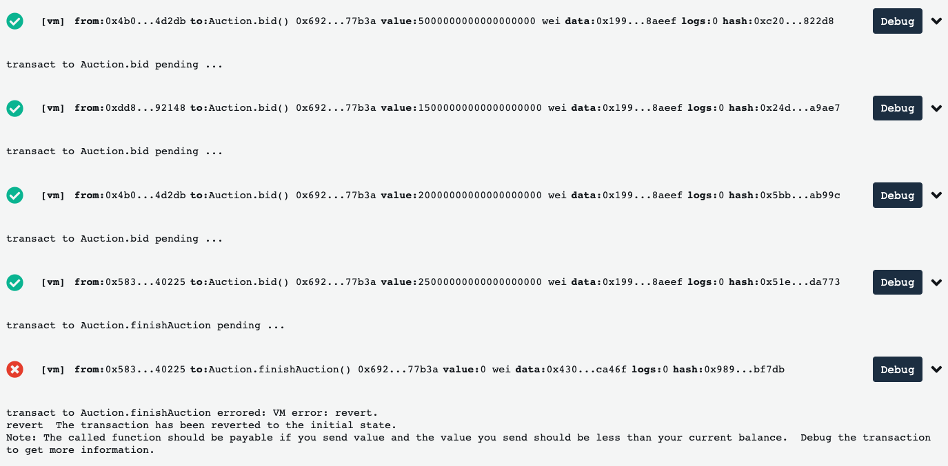

Slide 15
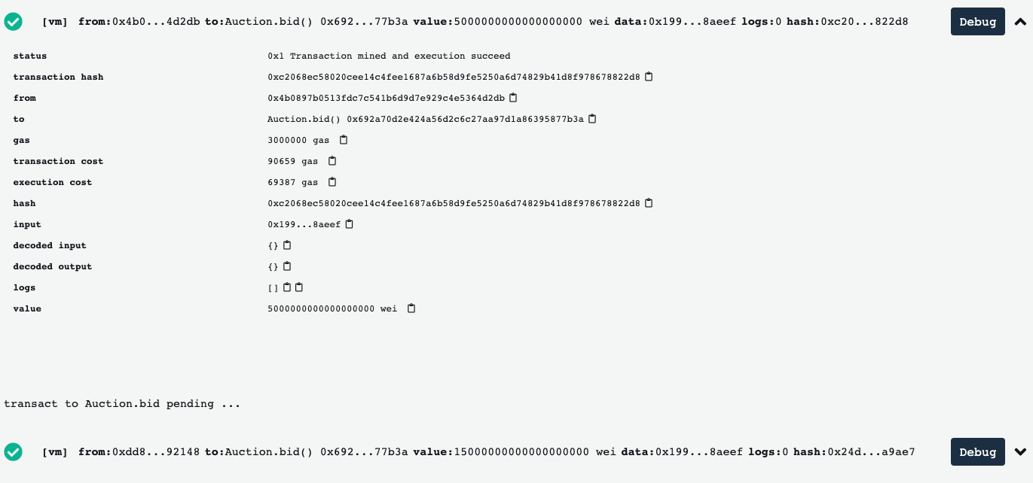

Slide 16
Conclusion
The project successfully met the criteria:
Smart contract of an auction
Addition of Vickrey auction

Slide 17

Future Research
Third-party timers
Automatic closing
Front-end
Different people are the bidders
dlpng.com

Slide 18
RUNNING AN AUCTION USING BLOCKCHAIN
Isha Patel

